Slide 1

Data Structures Using C++ 2E
Chapter 4
Standard Template Library (STL) I

Slide 2
Objectives
Learn about the Standard Template Library (STL)
Become familiar with the three basic components of the STL: containers, iterators, and algorithms
Explore how vector and deque containers are used to manipulate data in a program
Discover the use of iterators
Data Structures Using C++ 2E

Slide 3
Components of the STL
Program’s main objective is to manipulate data and generate results
  Requires ability to store data, access data, and manipulate data
STL components
  Containers: manage objects of a given type
  Iterators: step through container elements
  Algorithms: manipulate data
Containers and iterators
  Class templates
Data Structures Using C++ 2E

Slide 4
Container Types
STL containers categories
  Sequence containers (sequential containers)
    vector, deque, list, array, etc.
  Associative containers
    set, multiset, map, multimap, etc.
  Container adapters
    stack: LIFO, (default) adapts deque
    queue: FIFO, (default) adapts deque
    priority_queue: items in sorted order, (default) adapts vector
Data Structures Using C++ 2E

Slide 5
Sequence Containers
Every object has a specific position
Predefined sequence containers
  vector , deque , list
Sequence container vector
  Logically: same as arrays
  Processed like arrays
All containers
  Use same names for common operations
  Have container specific operations
Data Structures Using C++ 2E

Slide 6
Sequence Container: vector
Vector container
  Stores, manages objects of a type in a dynamic array
  Elements accessed randomly
  Time-consuming item insertion: middle, beginning
  Fast item insertion: end
  Class name: vector
Header file containing the class vector
  #include <vector>
Examples
  vector<int> intList;
  vector<string> stringList;
Data Structures Using C++ 2E

Slide 7
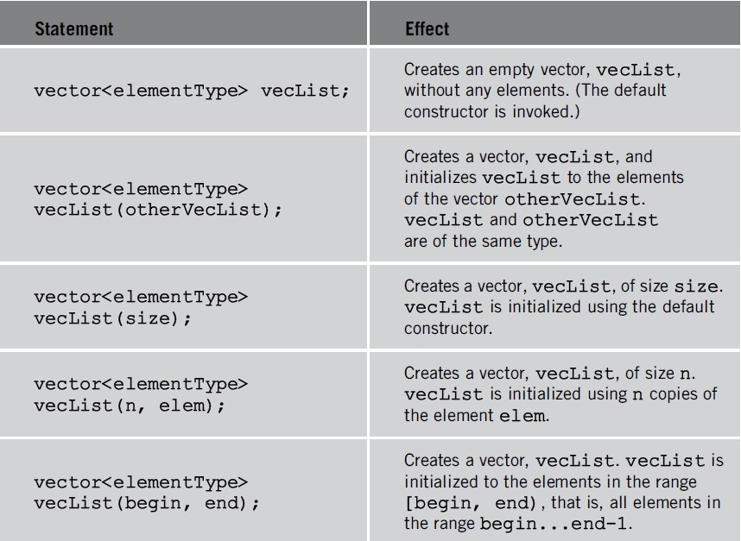
Sequence Container: vector (cont’d.)
Declaring vector objects
TABLE 4-1 Various ways to declare and initialize
a vector container
Data Structures Using C++ 2E

Slide 8
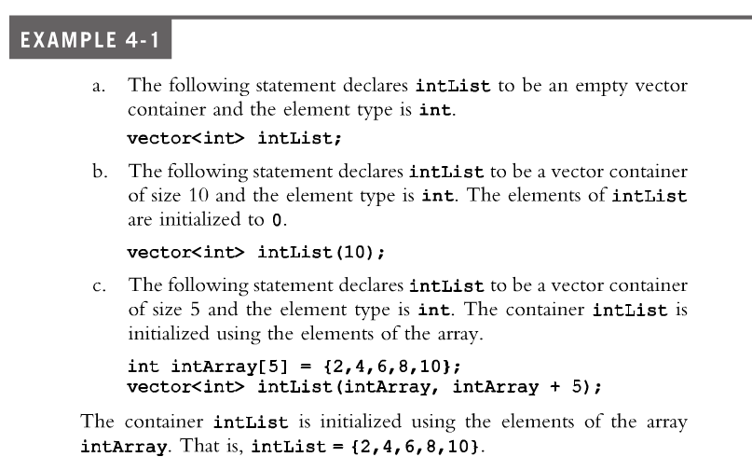
Sequence Container: vector (cont’d.)
Data Structures Using C++ 2E

Slide 9
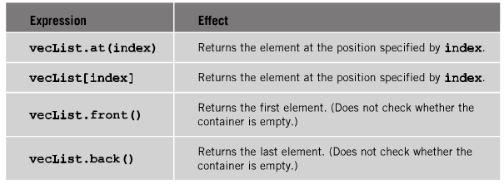
Sequence Container: vector (cont’d.)
Manipulating data stored in a vector sequence container
  Item insertion, deletion
  Stepping through the elements of a vector array
TABLE 4-2 Operations to access the elements of a vector container
Data Structures Using C++ 2E

Slide 10
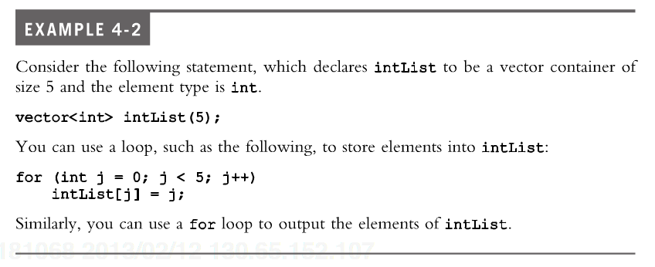
Sequence Container: vector (cont’d.)
The elements in a vector can be processed just as they can in an array
Data Structures Using C++ 2E

Slide 11
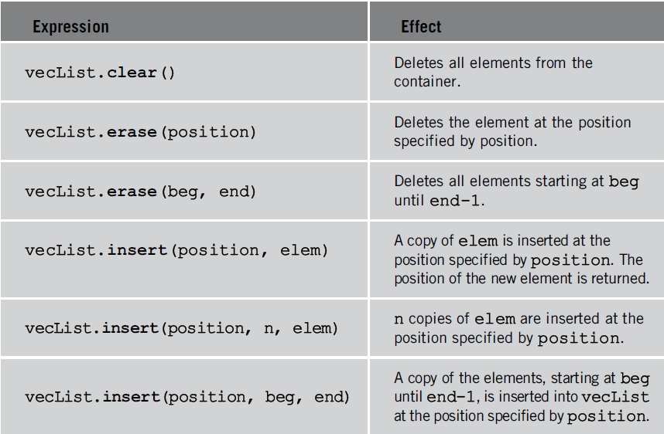
Sequence Container: vector (cont’d.)
TABLE 4-3 Various operations on a vector container
Data Structures Using C++ 2E

Slide 12
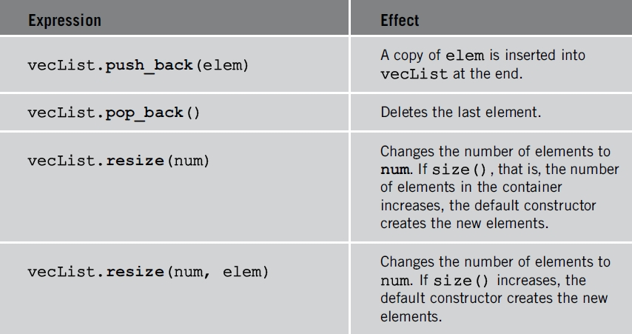
Sequence Container: vector (cont’d.)
TABLE 4-3 Various operations on a vector container (cont’d.)
Data Structures Using C++ 2E

Slide 13
Sequence Container: vector (cont’d.)
Function push_back
  Adds element to end of container
  You cannot use array subscripting operator [] to add an element beyond it’s size unless you grow the size of the container first
  Container size grows automatically as needed with push_back
  Used when declaring vector container
    Specific size unknown
Data Structures Using C++ 2E

Slide 14
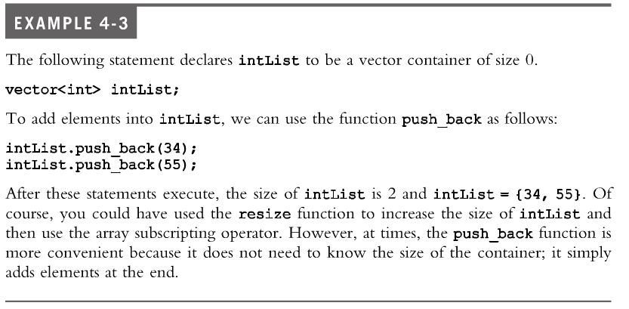
Sequence Container: vector (cont’d.)
Data Structures Using C++ 2E

Slide 15
Sequence Container: vector (cont’d.)
class vector
  Provides various operations to process vector container elements
  Iterator
    Argument position in STL terminology
    Works just like a pointer
    Used to step through the elements of a container
Data Structures Using C++ 2E

Slide 16
Declaring an Iterator to a Vector Container
You can process vector container like an array
  Using array subscripting operator []
Or process vector container elements
  Using an iterator
class vector: function insert
  vecList::insert(position, elem)
  Insert element at a specific vector container position
  Uses an iterator position
class vector: function erase
  vecList::erase(position)
  Remove element
  Uses an iterator position
Data Structures Using C++ 2E

Slide 17
Declaring an Iterator to a Vector Container (cont’d.)
class vector contains typedef iterator
  Declared as a public member
  Must use the container name (vector), element type, and scope resolution operator to use typedef iterator
  Vector container iterator
    Declared using typedef iterator
  Example
    vector<int>::iterator intVecIter;
    declares intVecIter to be an iterator into a vector container of type int
Data Structures Using C++ 2E

Slide 18
Iterator definition in STL vector
template <class _Tp>
class vector : protected _Vector_base<_Tp>
{
public:
typedef _Tp value_type;
typedef value_type* pointer;
typedef const value_type* const_pointer;
typedef value_type* iterator;
…
};
Data Structures Using C++ 2E

Slide 19
Declaring an Iterator to a Vector Container (cont’d.)
Requirements for using typedef iterator
  Container name (vector)
  Container element type
  Scope resolution operator
++intVecIter
  Advances iterator intVecIter to next element into the container
*intVecIter
  Returns element at current iterator position
Data Structures Using C++ 2E

Slide 20

Declaring an Iterator to a Vector Container (cont’d.)
Using an iterator into a vector container
  Manipulating element type to be int
Data Structures Using C++ 2E

Slide 21
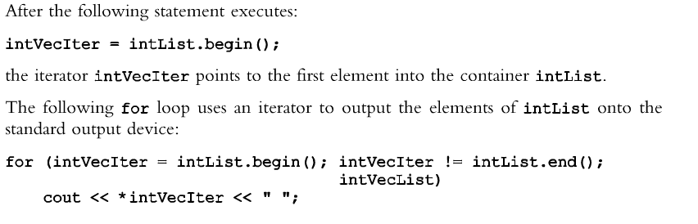
Containers and the Functions begin and end
begin()
  Returns position of the first element into the container
end()
  Returns position one after the last element of the container
++
Data Structures Using C++ 2E

Slide 22
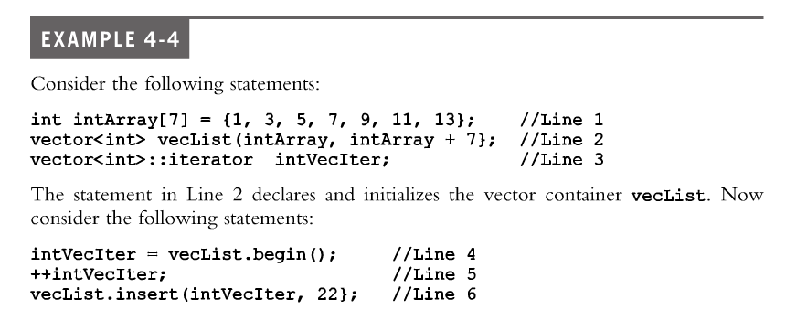
Containers and the Functions begin and end
What is the value of vecList after the following code is executed?
Data Structures Using C++ 2E

Slide 23
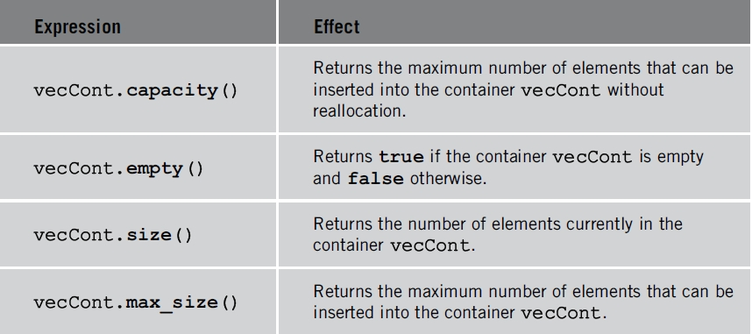
Containers and the Functions begin and end (cont’d.)
TABLE 4-4 Functions to determine the size of a vector container
Data Structures Using C++ 2E

Slide 24
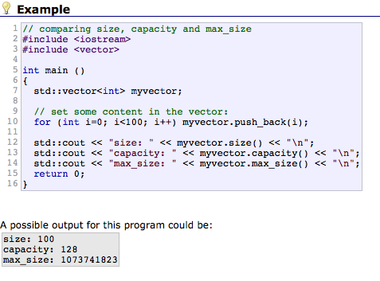
Example: vector
Data Structures Using C++ 2E

Slide 25
Member Functions Common to All Containers
Examples
  Default constructor
  Several constructors with parameters
  Destructor
Class encapsulates data, operations on that data into a single unit
Every container is a class
  Several operations directly defined for a container
  Provided as part of class definition
Data Structures Using C++ 2E

Slide 26
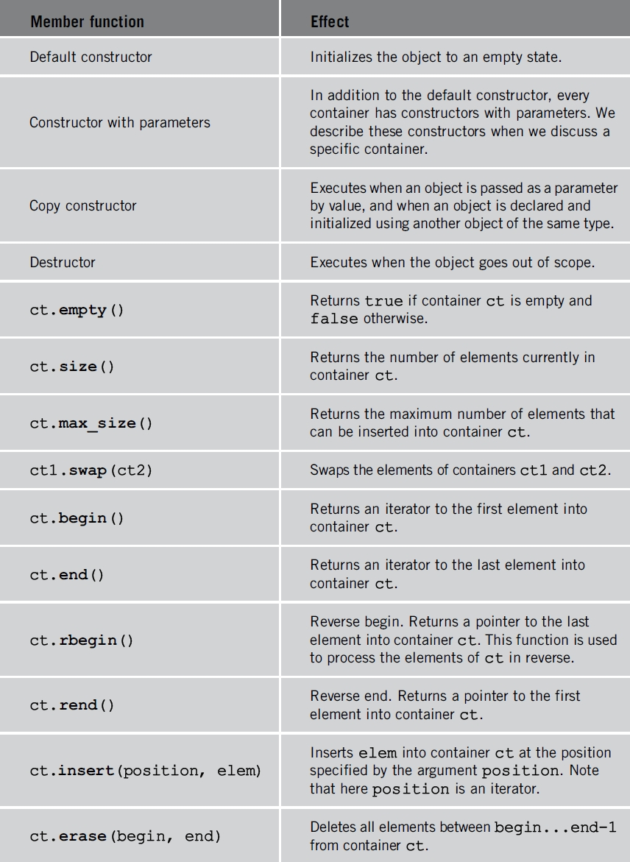
TABLE 4-5 Member functions common to all containers
One after the last element
One before the first element
Data Structures Using C++ 2E

Slide 27
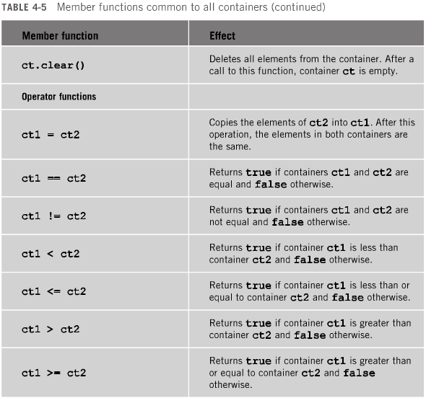
Data Structures Using C++ 2E

Slide 28
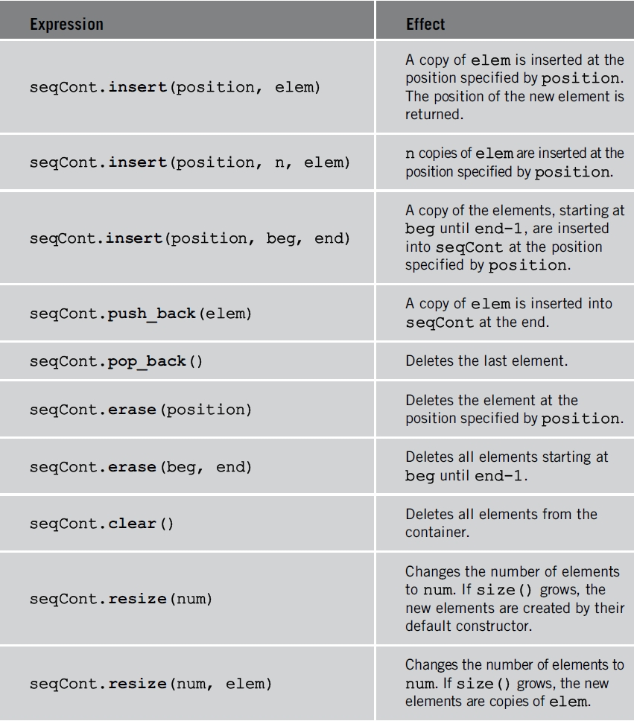
Member Functions Common to Sequence Containers
TABLE 4-6 Member functions common to all sequence containers
Data Structures Using C++ 2E

Slide 29
The copy Algorithm
Provides convenient way to output container elements
Generic STL algorithm
  Usable with any container type and arrays
Does more than output container elements
  Allows copying of elements from one place to another
Function template copy definition
  Contained in header file algorithm
Data Structures Using C++ 2E

Slide 30
ostream Iterator and Function copy
Output container contents
  Use a for loop and the function begin
    Use the function end to set limit
  Use Function copy
    ostream iterator type specifies destination
Creating an iterator of type ostream
  Specify element type iterator will output
Function copy
  Can output container elements using ostream iterator
  Directly specify ostream iterator in function copy
Data Structures Using C++ 2E

Slide 31
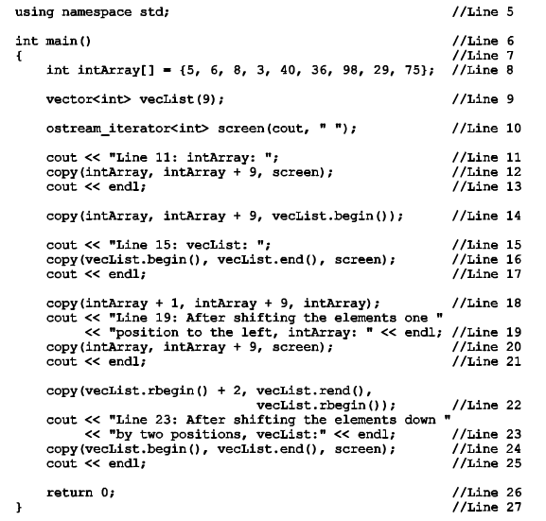
Data Structures Using C++ 2E

Slide 32
Sequence Container: deque
Deque: double-ended queue
Implemented as dynamic arrays
  Can expand in either direction
Class name defining deque container
  deque
Header file deque contains
  Definition of the class deque
  Functions to implement various operations on a deque object
Class deque contains several constructors
Data Structures Using C++ 2E

Slide 33
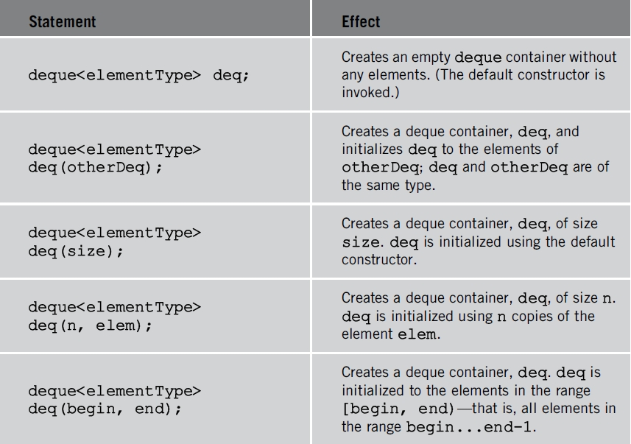
Sequence Container: deque (cont’d.)
TABLE 4-7 Various ways to declare a deque object
Data Structures Using C++ 2E

Slide 34
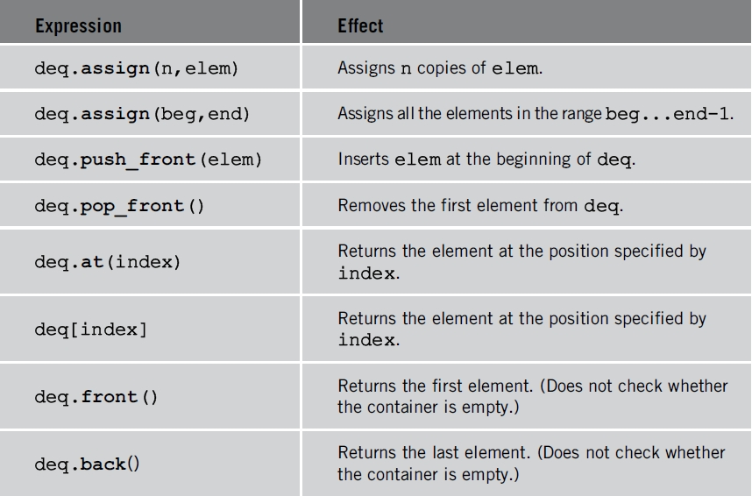
Sequence Container: deque (cont’d.)
TABLE 4-8 Various operations that can be performed
on a deque object
Data Structures Using C++ 2E

Slide 35
STL Iterators
Work like pointers
Point to elements of a container (sequence or associative)
Allow successive access to each container element
Two most common operations on iterators
  ++ (increment operator)
  * (dereferencing operator)
Examples
  ++cntItr;
  *cntItr;
Data Structures Using C++ 2E

Slide 36
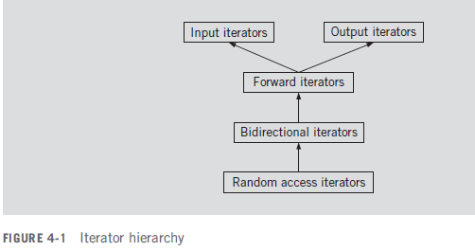
Types of Iterators
Input iterators
Output iterators
Forward iterators
Bidirectional iterators
Random access iterators
Data Structures Using C++ 2E

Slide 37
Input Iterators
Read access
  Step forward element-by-element
  Return values element-by-element
Provided for reading data from an input stream
Data Structures Using C++ 2E

Slide 38
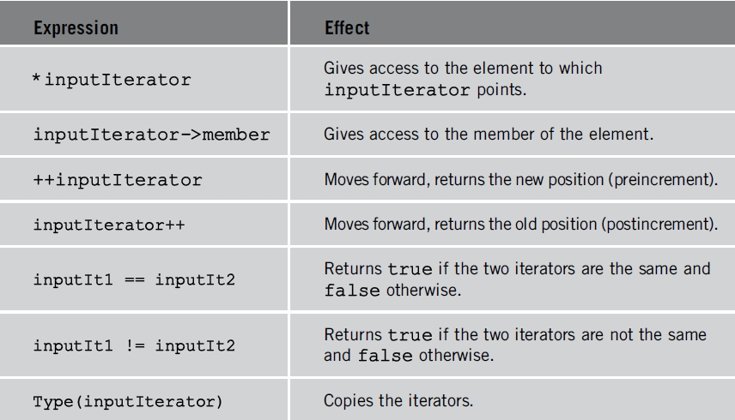
Input Iterators (cont’d.)
TABLE 4-9 Operations on an input iterator
Data Structures Using C++ 2E

Slide 39
Output Iterators
Write access
  Step forward element-by-element
Used for writing data to an output stream
Cannot be used to iterate over a range twice
  If we write data at the same position twice, there is no guarantee that the new value will replace the old value. Hint: ostream_iterator
Data Structures Using C++ 2E

Slide 40
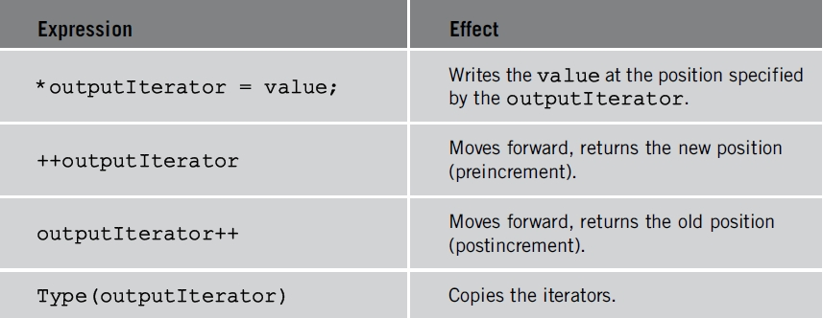
Output Iterators (cont’d.)
TABLE 4-10 Operations on an output iterator
Data Structures Using C++ 2E

Slide 41
Forward Iterators
Combination of
  All of input iterators functionality and almost all output iterators functionality
Can refer to same element in same collection
  Can process same element more than once
Data Structures Using C++ 2E

Slide 42
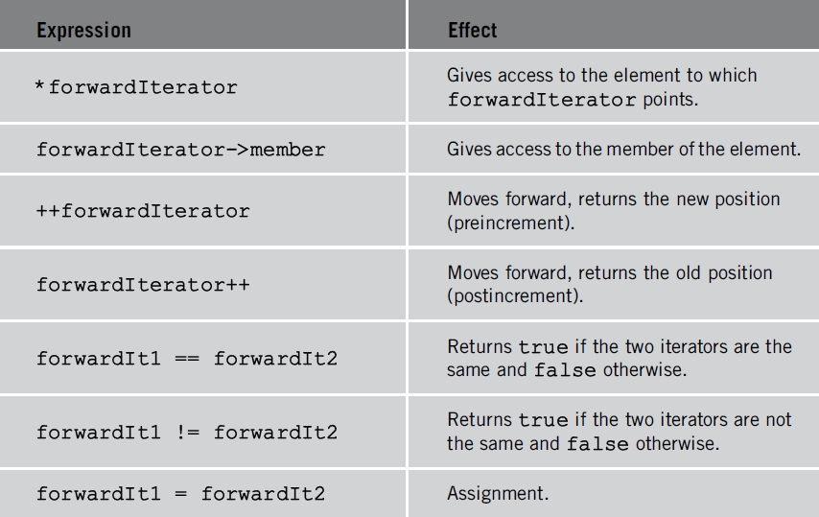
Forward Iterators (cont’d.)
TABLE 4-11 Operations on a forward iterator
Data Structures Using C++ 2E

Slide 43
Bidirectional Iterators
Forward iterators that can also iterate backward over the elements
Operations defined for forward iterators applicable to bidirectional Iterators
To step backward
  Decrement operations also defined for biDirectionalIterator
Can be used only with containers of type:
  vector, deque, list, set, multiset, map, and multimap
Data Structures Using C++ 2E

Slide 44
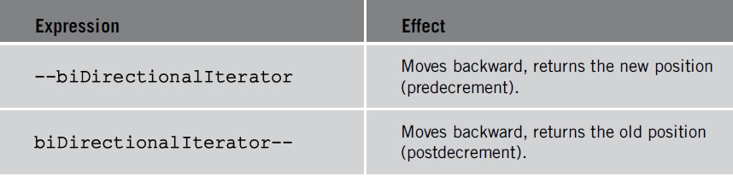
Bidirectional Iterators (cont’d.)
TABLE 4-12 Additional operations on a bidirectional iterator
Data Structures Using C++ 2E

Slide 45
Random Access Iterators
Bidirectional iterators that can randomly process container elements
Can be used with containers of type:
  vector , deque , string, and arrays
Operations defined for bidirectional iterators applicable to random access iterators
Data Structures Using C++ 2E

Slide 46
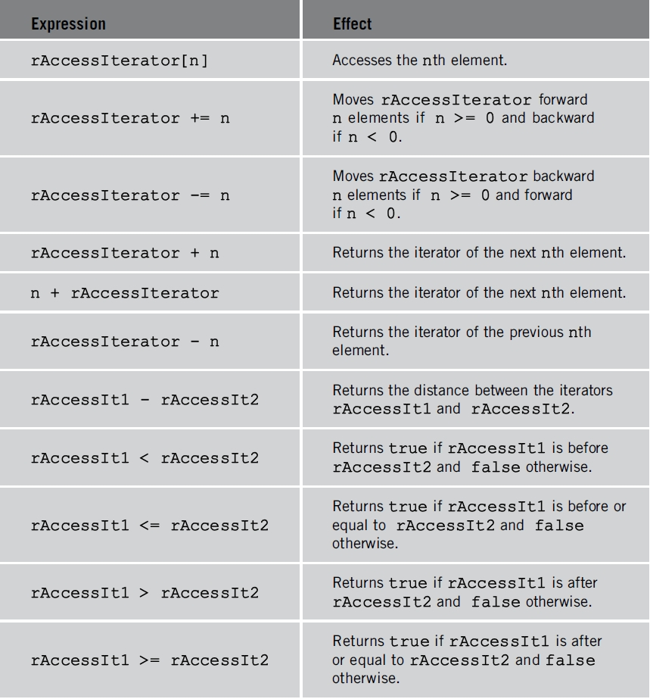
Random Access Iterators (cont’d.)
TABLE 4-13 Additional operations on a random access iterator
Data Structures Using C++ 2E

Slide 47
Iterators (cont’d.)
typedef iterator
  Every container (sequence or associative) contains a typedef iterator
  Iterator into a container declared using typedef iterator
  Must use appropriate container name, container element type, scope resolution operator
Data Structures Using C++ 2E

Slide 48
Iterators (cont’d.)
typedef const_iterator
  Modify container elements using an iterator into a container and dereferencing operator (*)
  Prevents iterator from modifying elements of container declared as constant
  Every container contains typedef const_iterator
  Read-only iterator
typedef reverse_iterator
  Every container contains typedef reverse_iterator
  Used to iterate through the elements of a container in reverse
Data Structures Using C++ 2E

Slide 49
Iterators (cont’d.)
typedef const_reverse iterator
  Read-only iterator
  Used to iterate through elements of a container in reverse
  Required if
    Container declared as const
    Need to iterate through the elements of the container in reverse
Data Structures Using C++ 2E

Slide 50
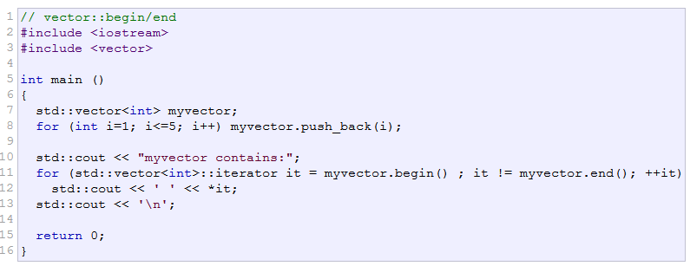
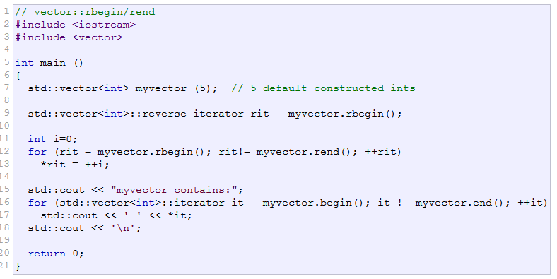
Data Structures Using C++ 2E

Slide 51
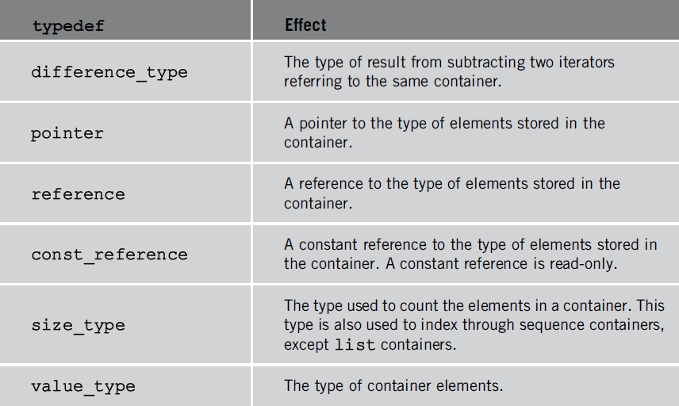
Iterators (cont’d.)
TABLE 4-14 Various typedefs common to all containers
Data Structures Using C++ 2E

Slide 52
Stream Iterators
istream_iterator
  Used to input data into a program from an input stream
  class istream_iterator
    Contains definition of an input stream iterator
  General syntax to use an istream iterator
Data Structures Using C++ 2E

Slide 53
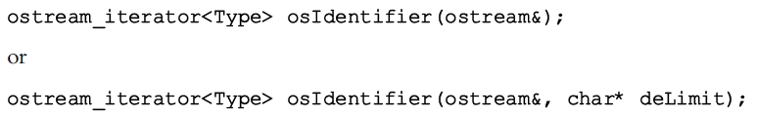
Stream Iterators (cont’d.)
ostream iterators
  Used to output data from a program into an output stream
  class ostream_iterator
    Contains definition of an output stream iterator
  General syntax to use an ostream iterator
Data Structures Using C++ 2E

Slide 54
Summary
STL
  Provides class templates
    Process lists, stacks, and queues
  Three main components
    Containers, iterators, and algorithms
  STL containers: class templates
Iterators
  Step through the elements of a container
Algorithms
  Manipulate elements in a container
Data Structures Using C++ 2E

Slide 55
Summary (cont’d.)
Main categories of containers
  Sequence containers, associative containers, container adapters
Three predefined sequence containers
  vector, deque, and list
copy algorithm
  Copies elements in a given range to another place
Function copy, using an ostream iterator
  Can output the elements of a container
Five categories of iterators: input, output, forward, bidirectional, random access iterator
Data Structures Using C++ 2E

Slide 56
Self Exercises
Programming Exercises: 4, 8, 10
Data Structures Using C++ 2E

